Slide 1
CCTH in Visual Weather
by Vinko Šoljan

Slide 2
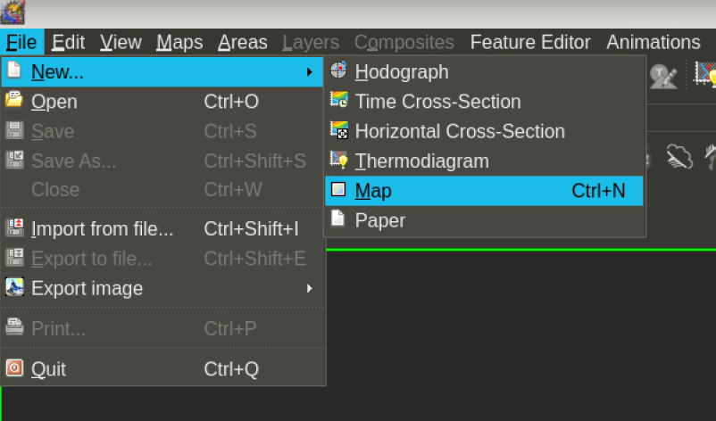
Map Editor

Slide 3
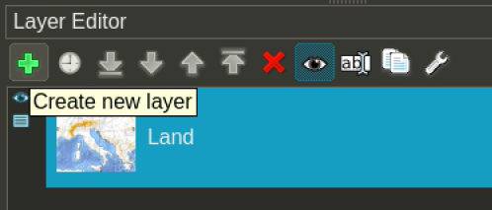
Map Editor

Slide 4
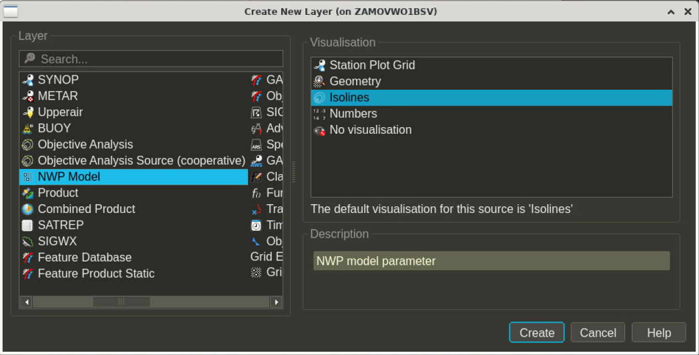

Slide 5
You must have equivalent potential temperature at levels 1000-600hPa (at least at standard levels, e.g. 1000, 950, 900, 850, 800, 750, 700, 650, 600hPa) if your NWP does not have that you can set it up in Field Diagnostic to calculate those fields when NWP arrives)

Slide 6
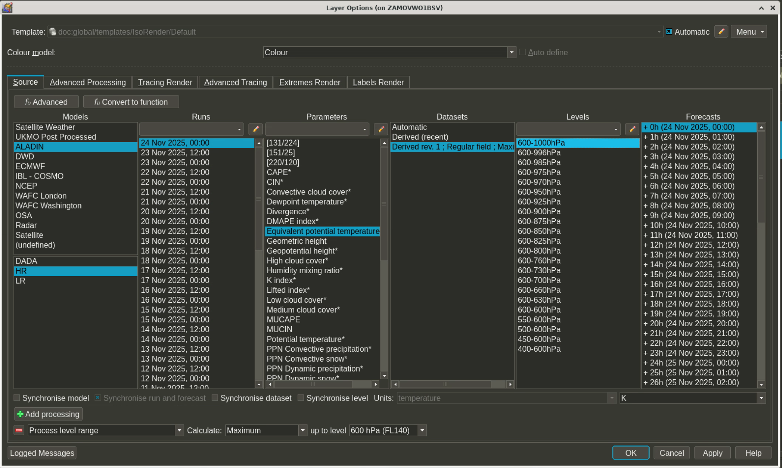

Slide 7
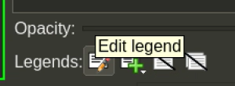
At Legends options you can turn off all „source” so those text boxes do not show on map

Slide 8
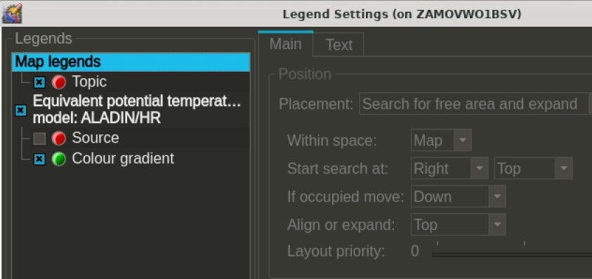

Slide 9
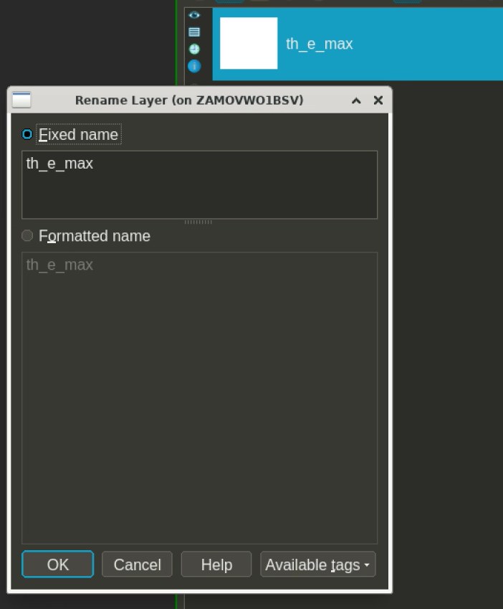
Rename this layer to „th_e_max”

Slide 10
„th_e_max” layer options

Slide 11
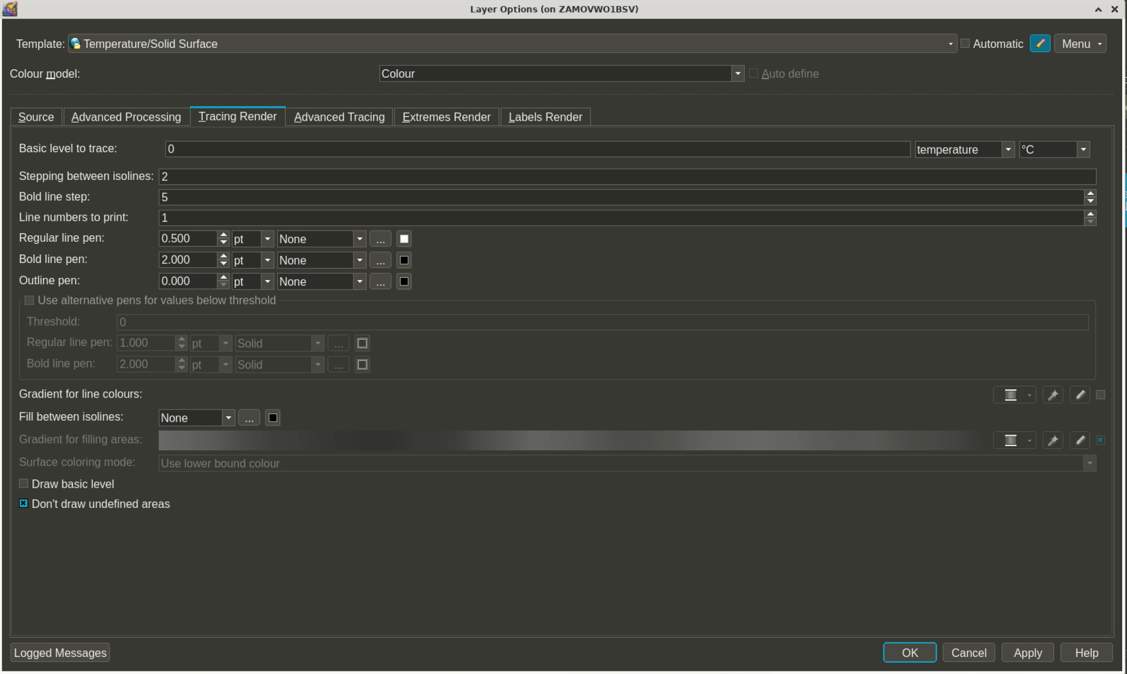

Slide 12
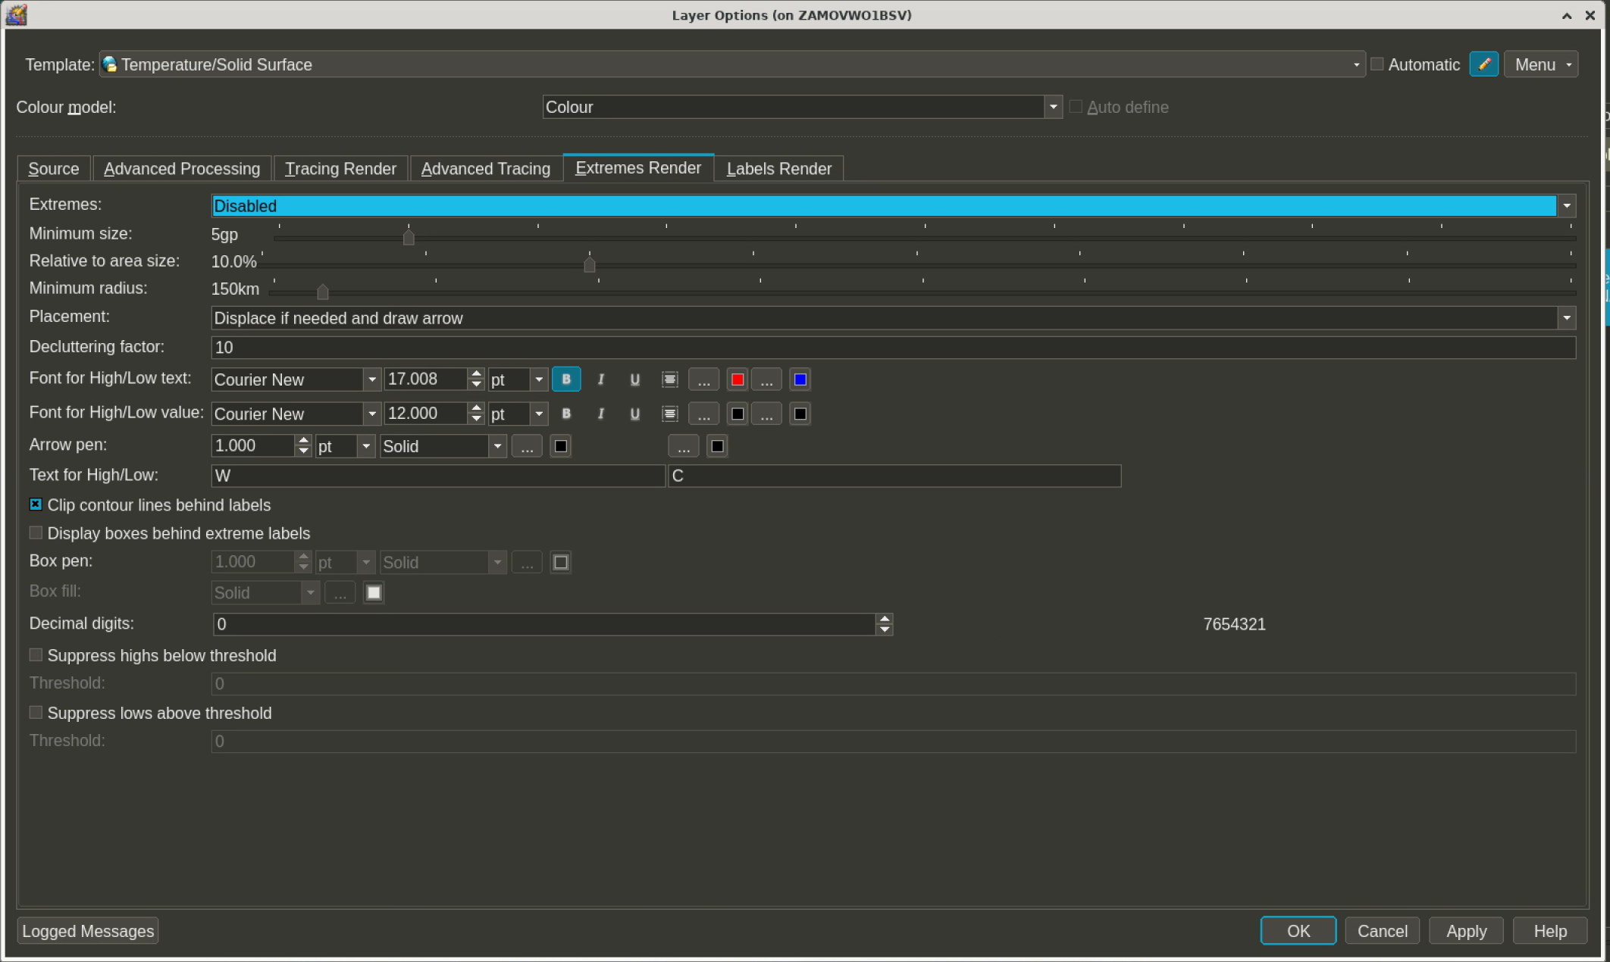

Slide 13
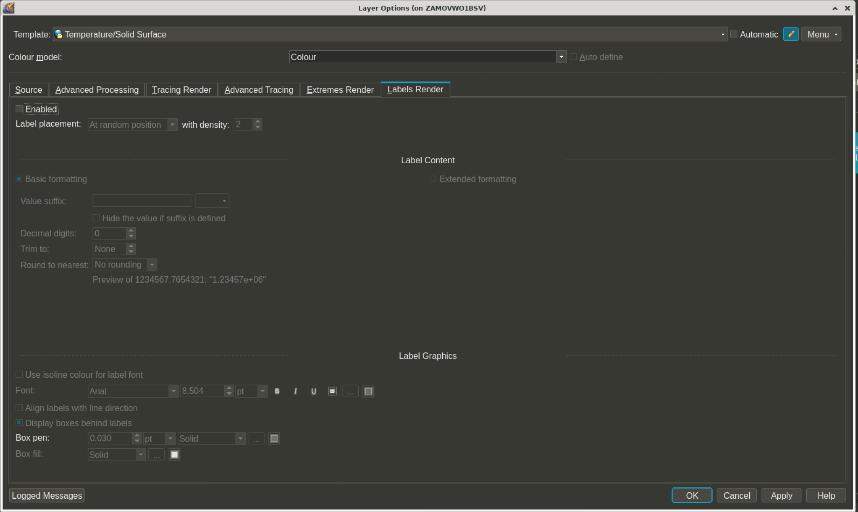

Slide 14
Create new layer „Product” > „Bitmap”
This is for satellite sandwich visualization. It is basically HRV VIS overlayed with IR 10.8 (40% transparency). So if you already have some sat layers you can insert them here.

Slide 15
HRV VIS layer

Slide 16
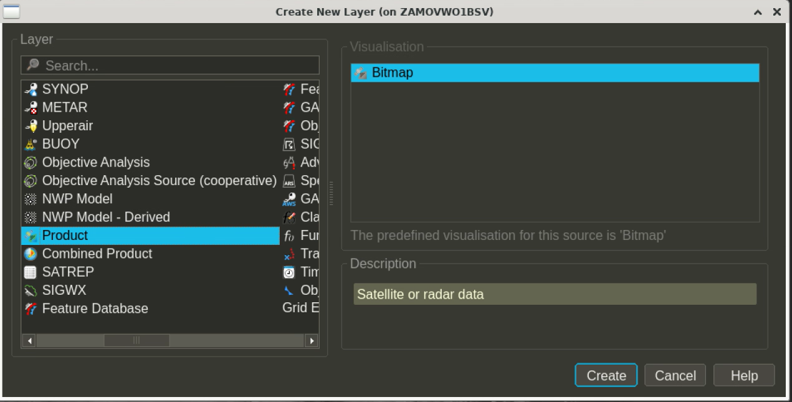

Slide 17
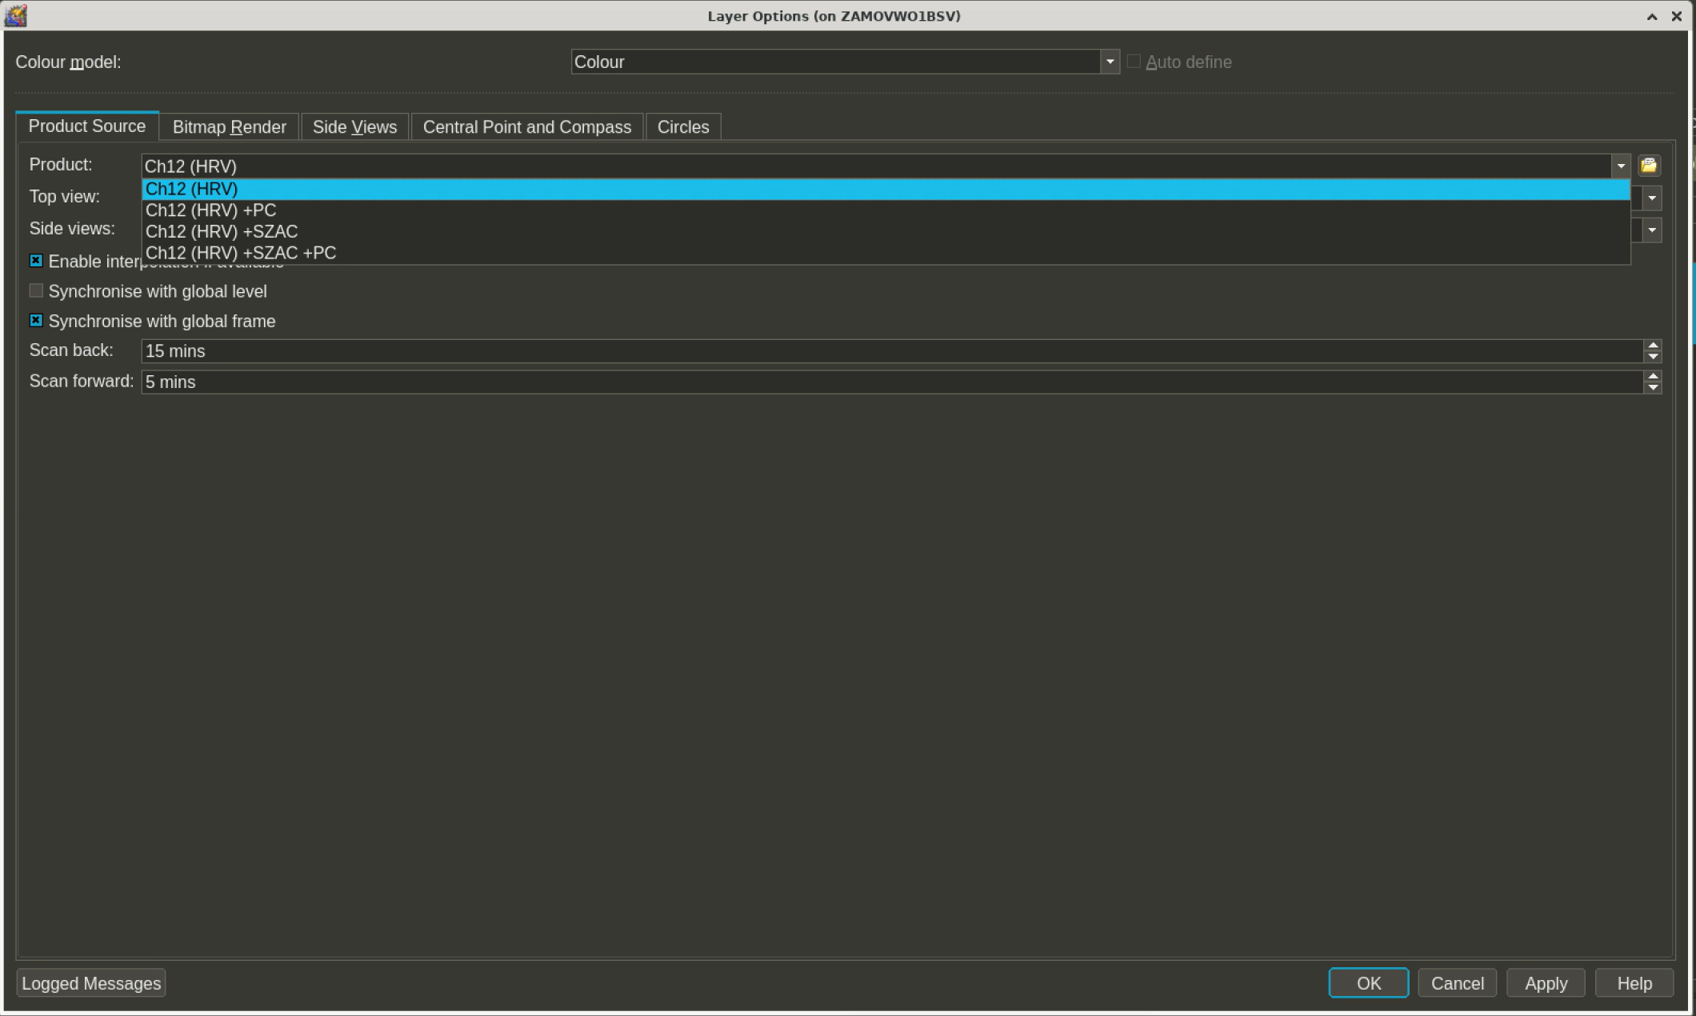

Slide 18
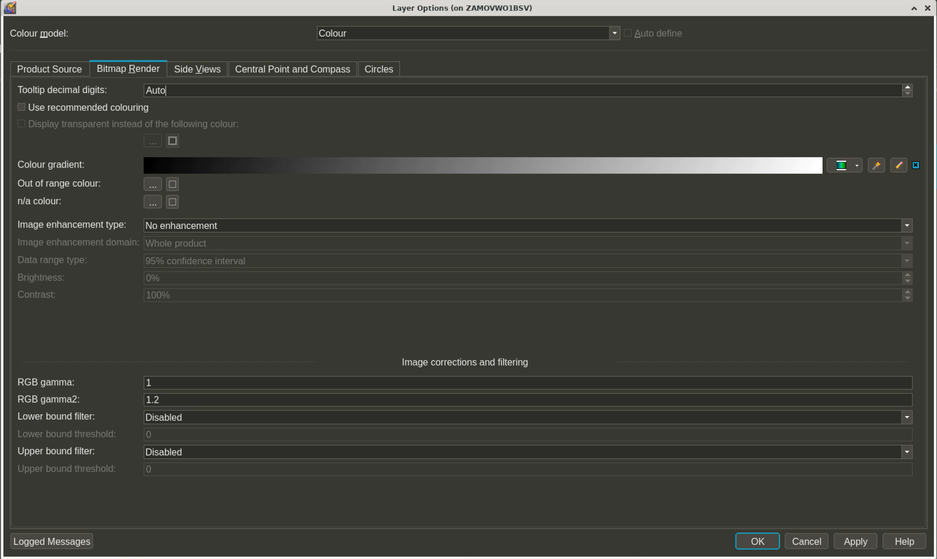

Slide 19
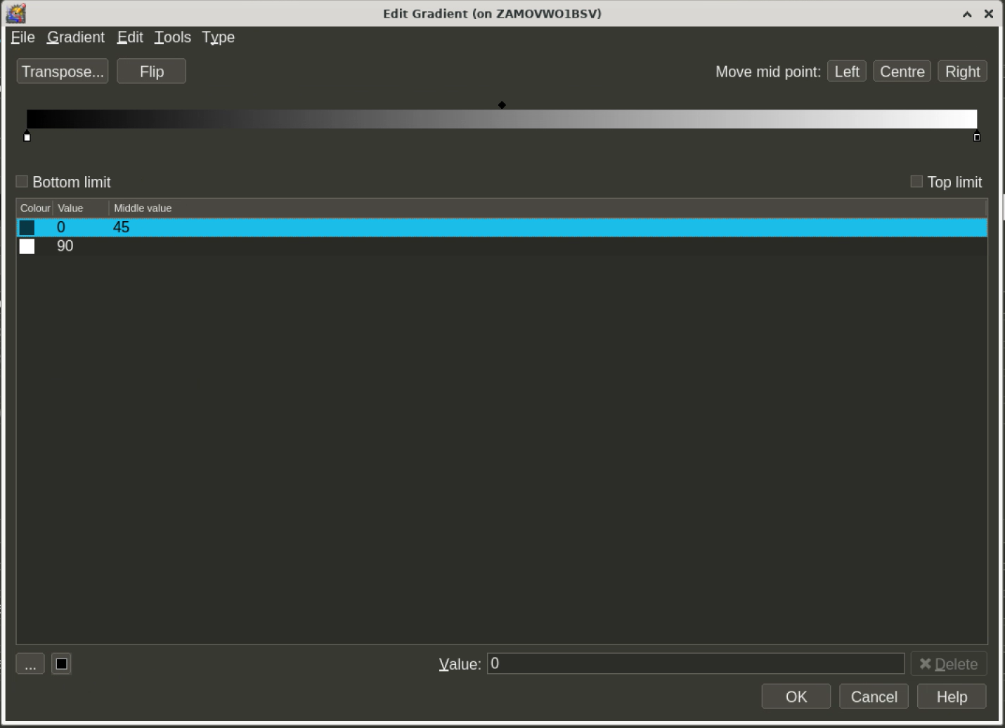

Slide 20
IR 10.8 layer

Slide 21
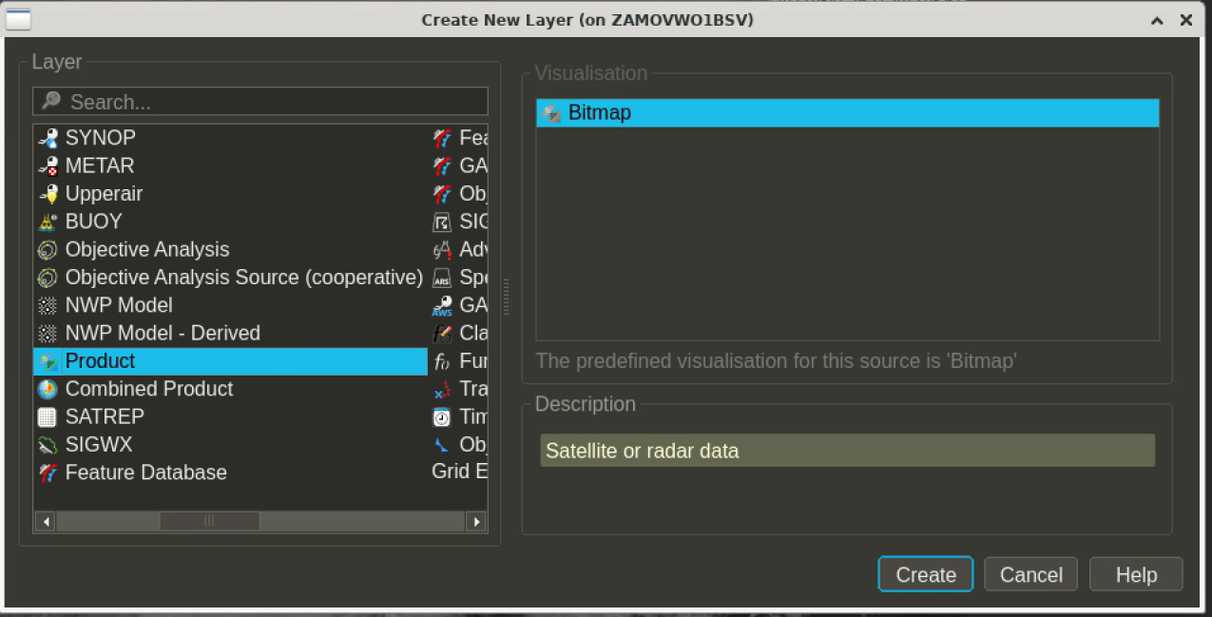

Slide 22
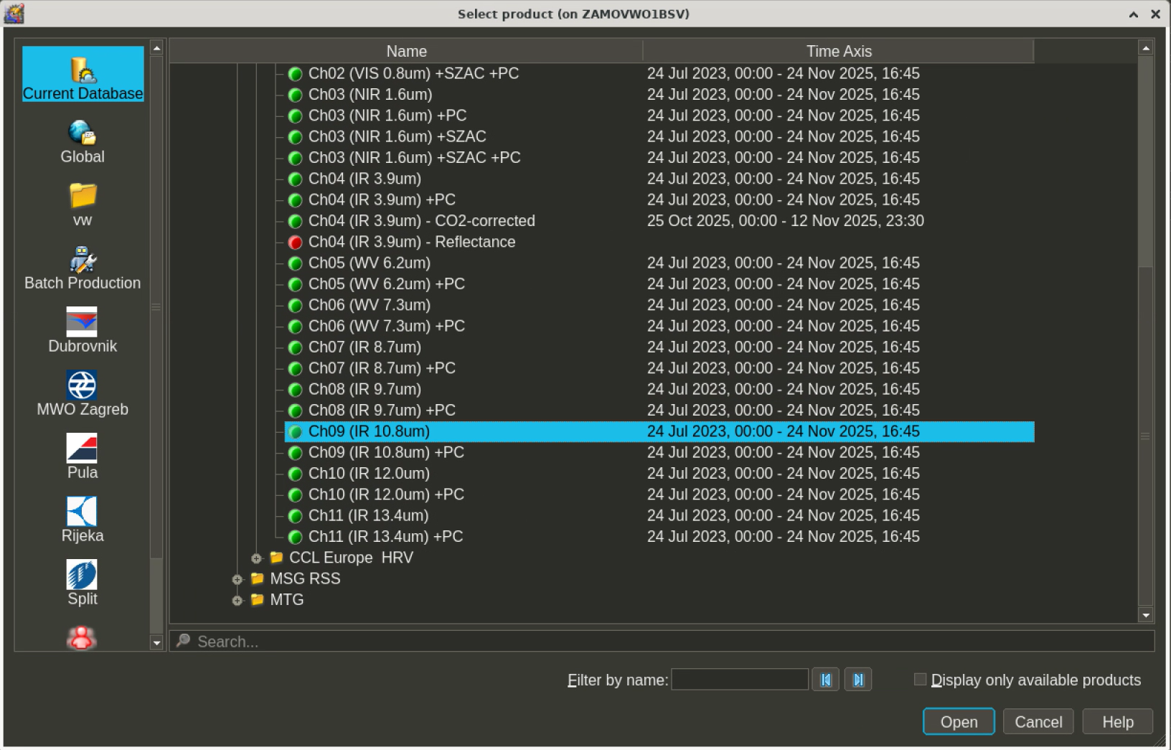

Slide 23
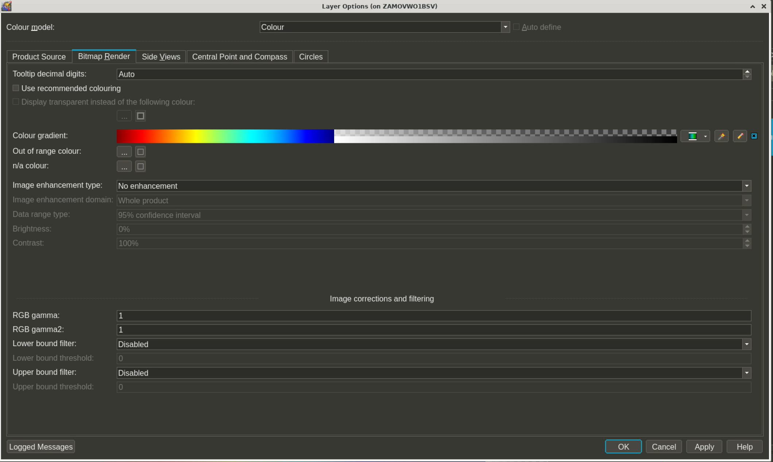

Slide 24
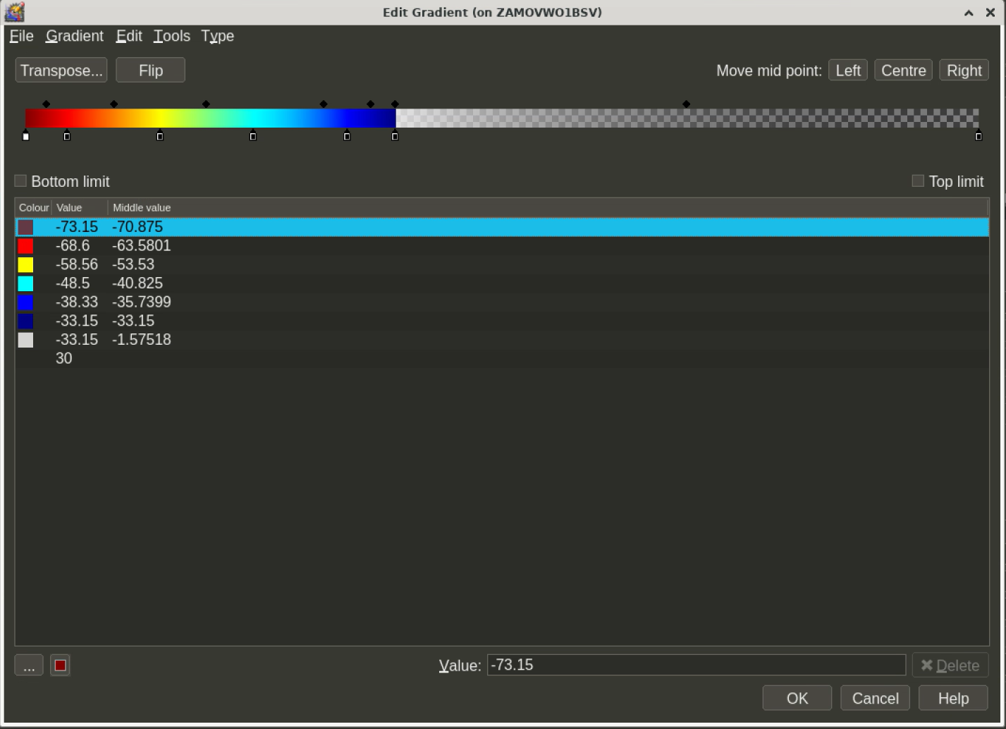

Slide 25
Brightness temperature (IR 10.8) layer „BT”
This is where CTH will get BT values from

Slide 26
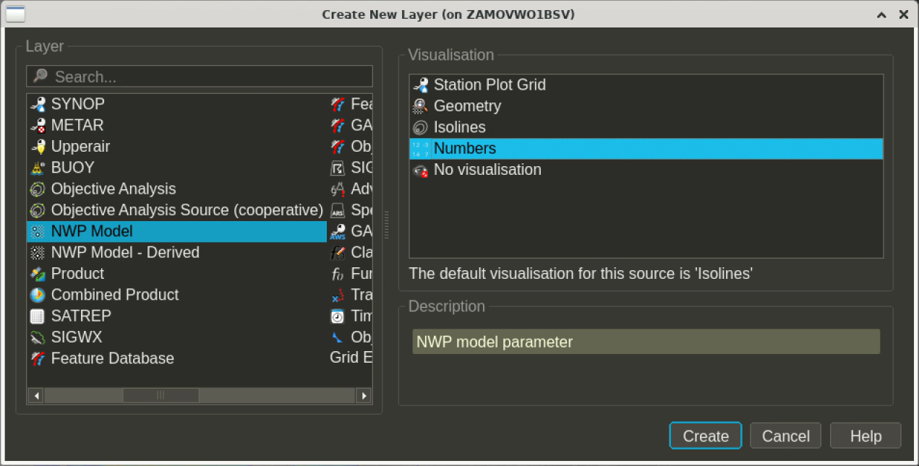

Slide 27
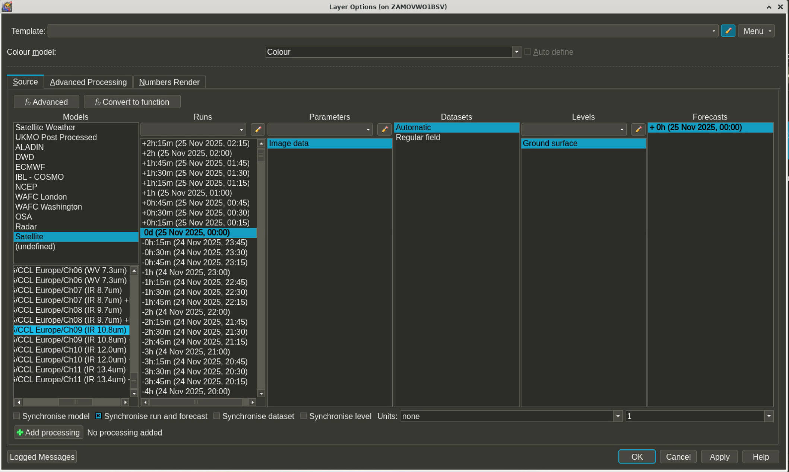

Slide 28
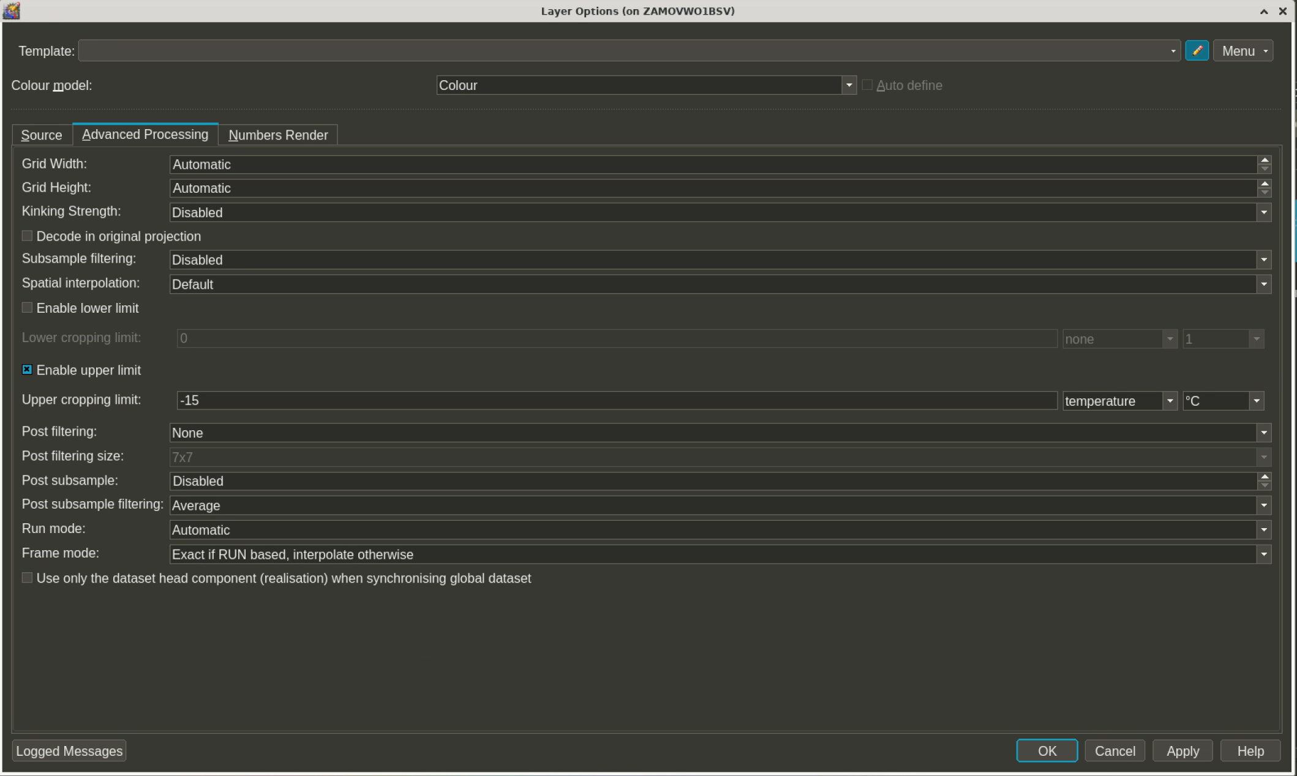
We want values only for tops colder than -15C

Slide 29
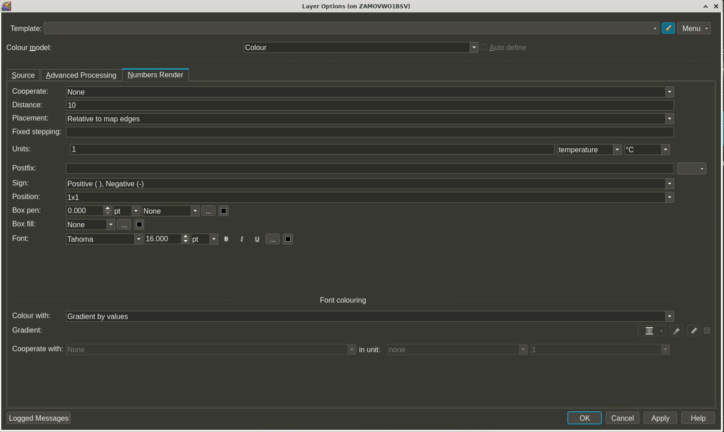

Slide 30

Rename this IR 10.8 BT layer to „BT”

Slide 31
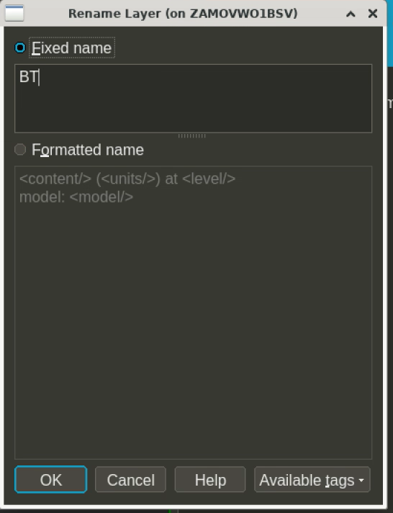

Slide 32
CCTH layer – it uses equation with CTH
function to calculate CTH from
th_e_max and BT layers

Slide 33
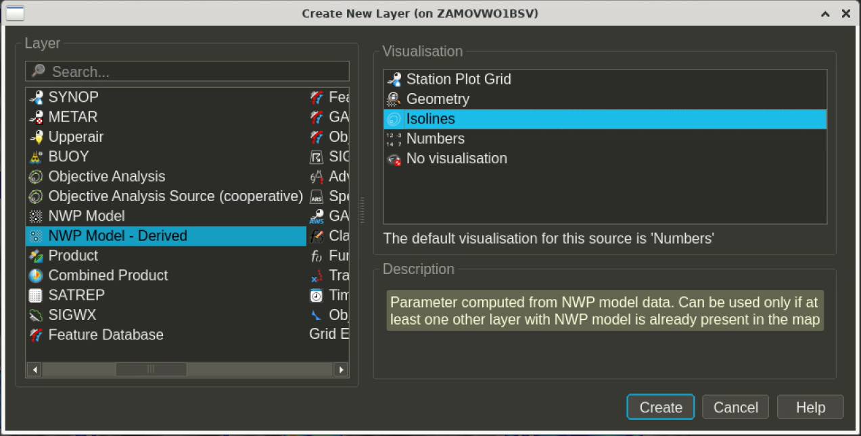

Slide 34
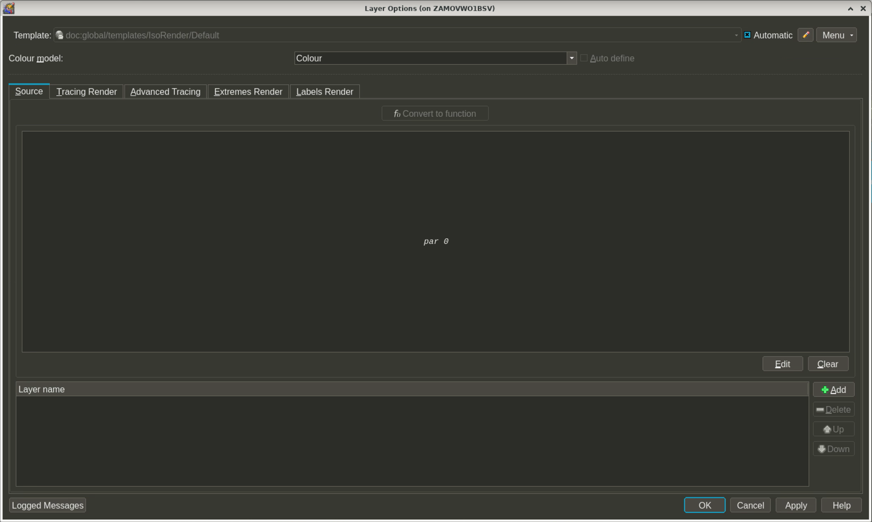

Slide 35
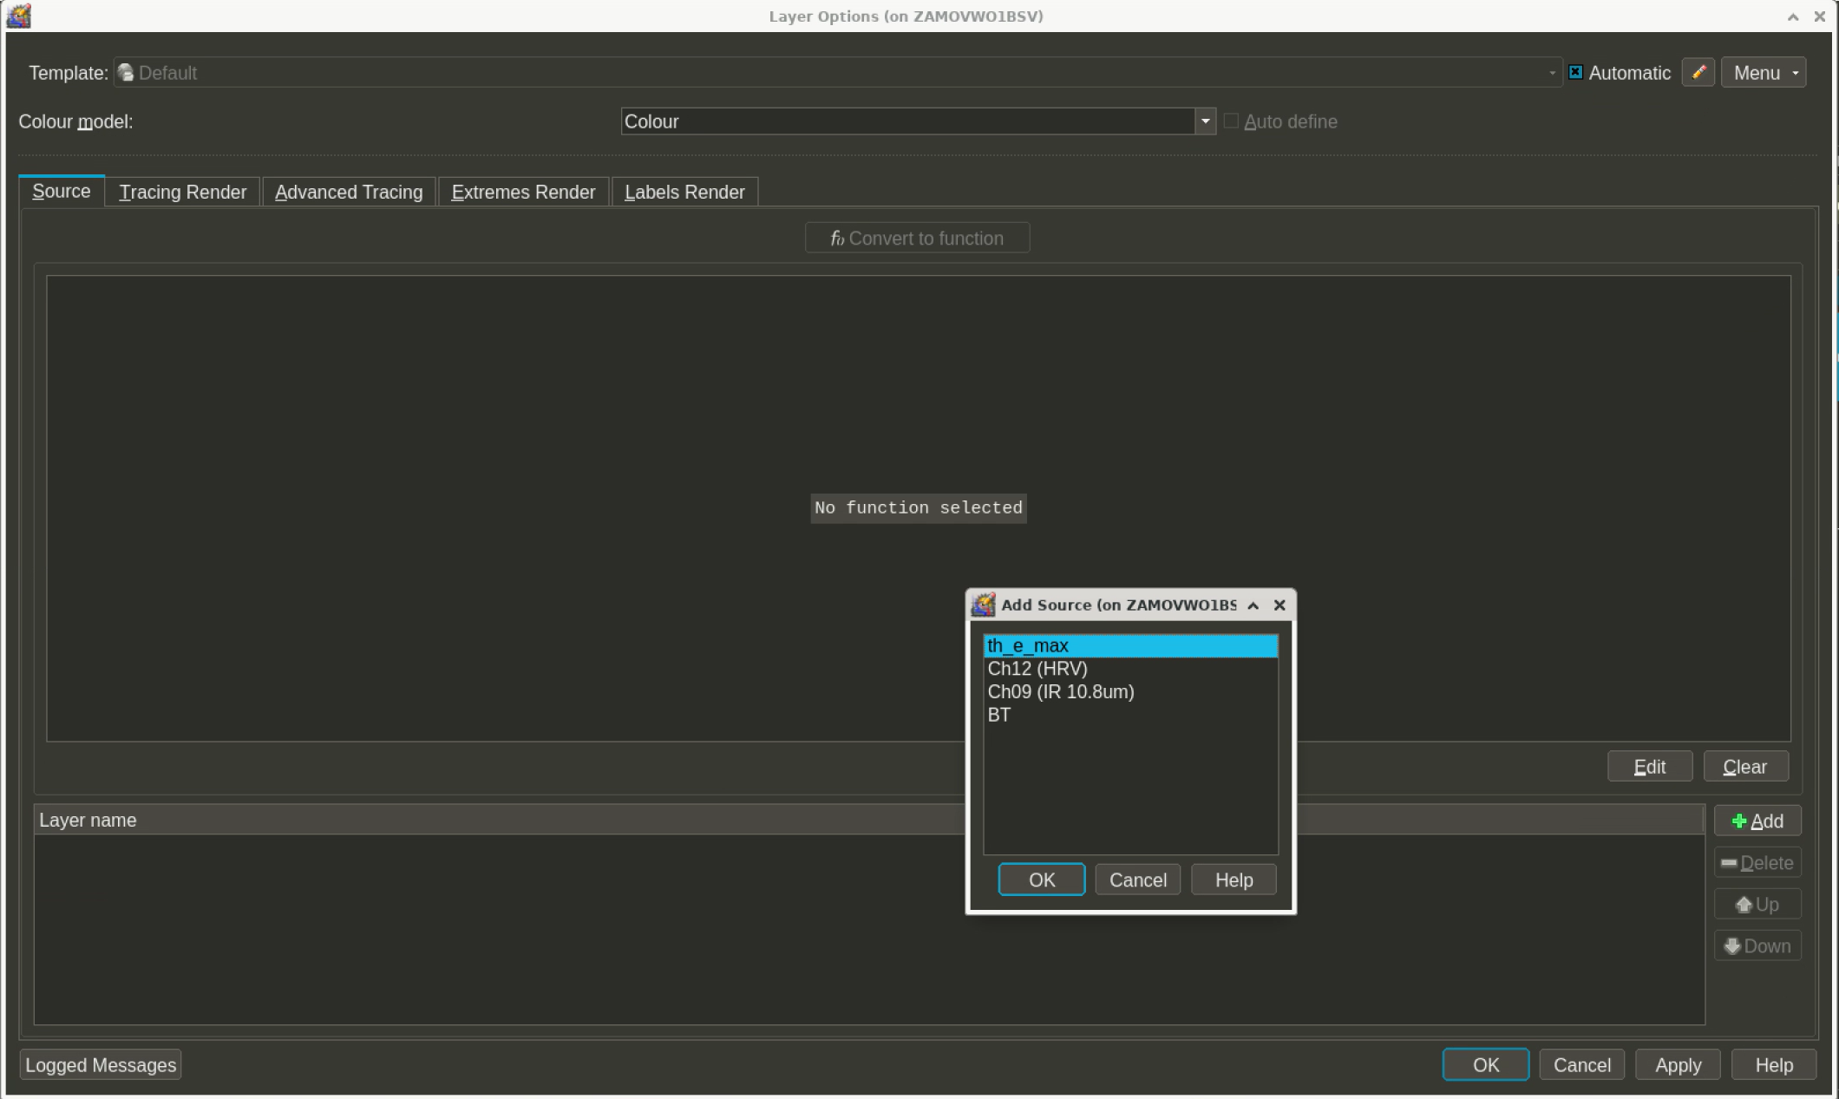

Slide 36
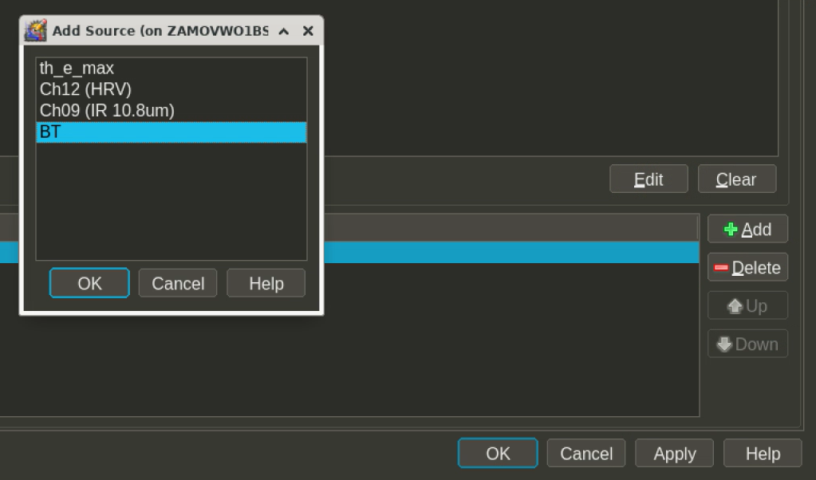

Slide 37
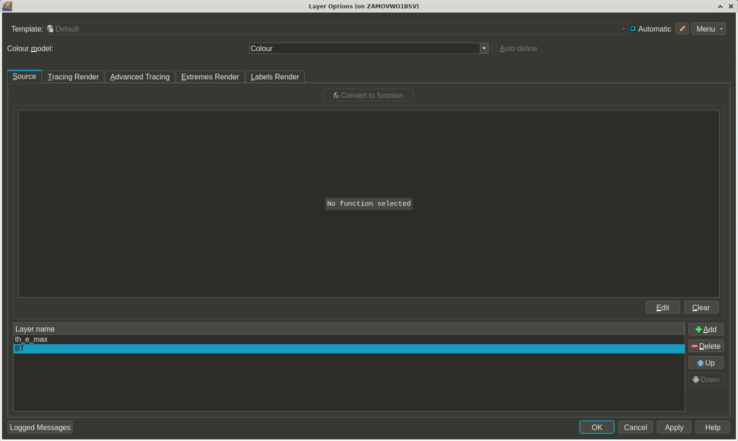
CLICK HERE

Slide 38
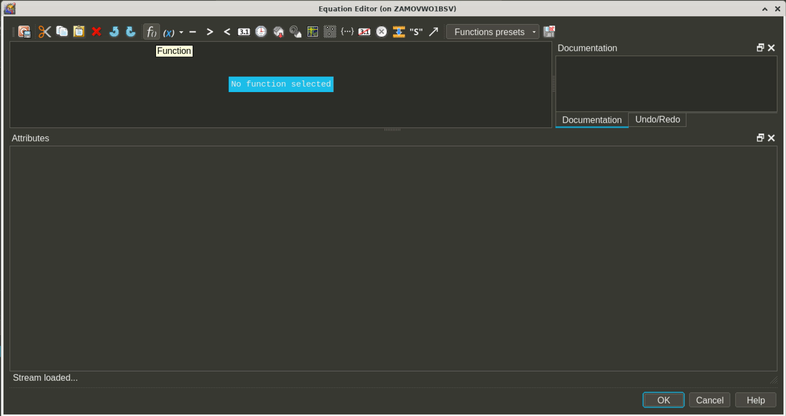

Slide 39
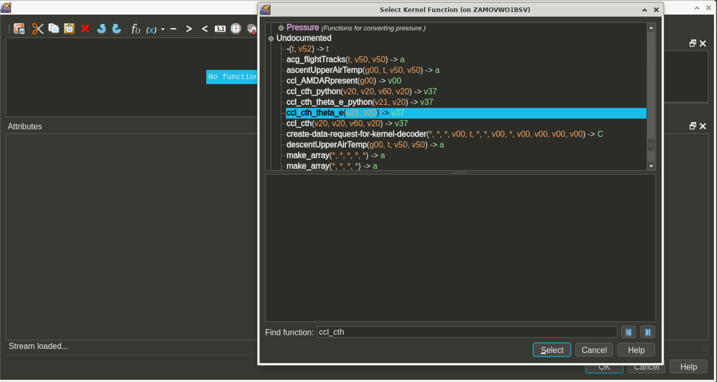

Slide 40
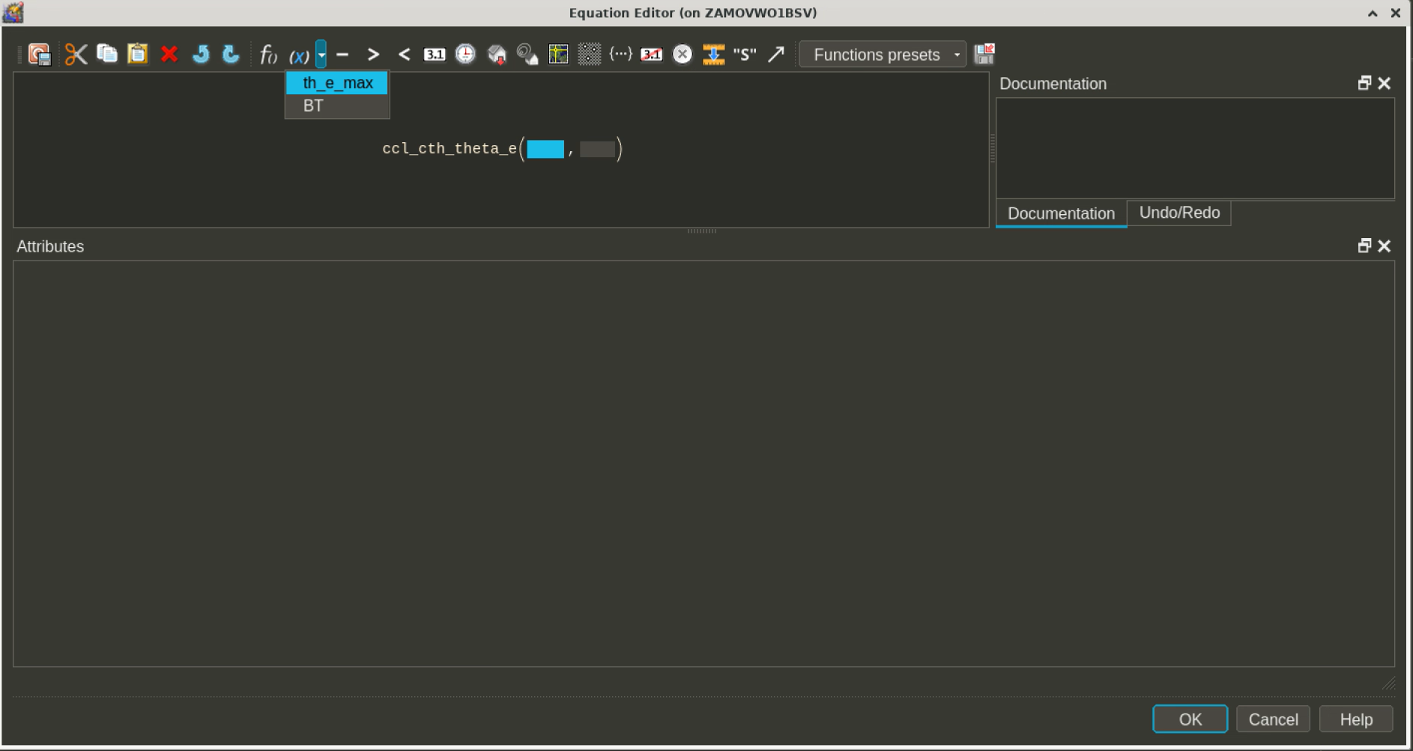

Slide 41
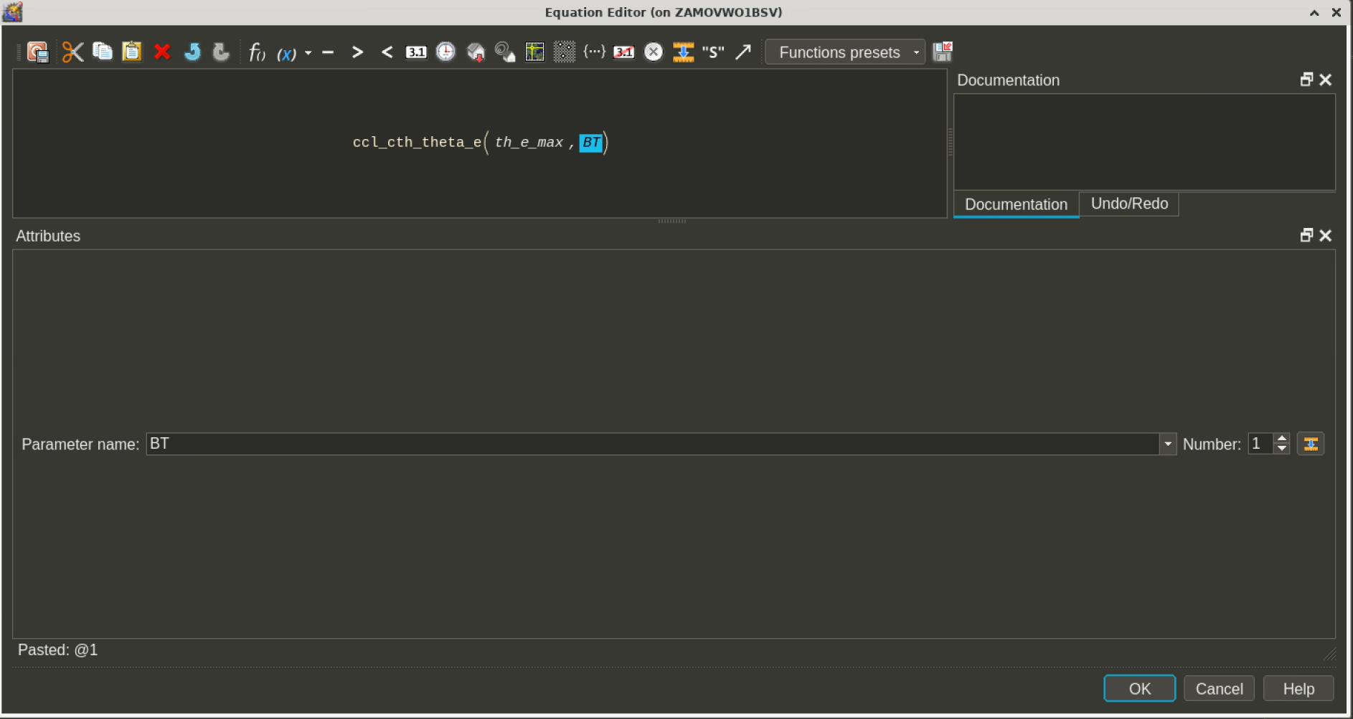

Slide 42
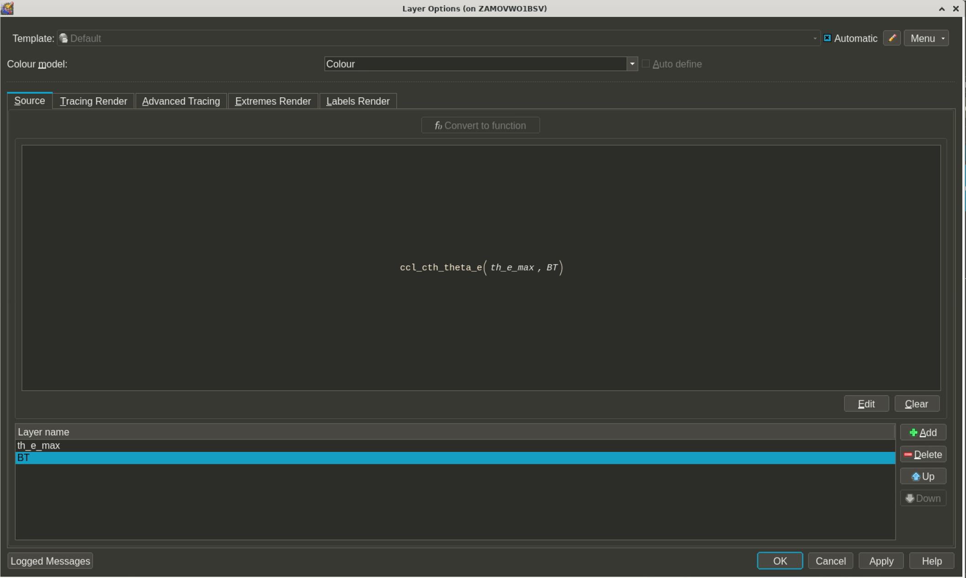

Slide 43
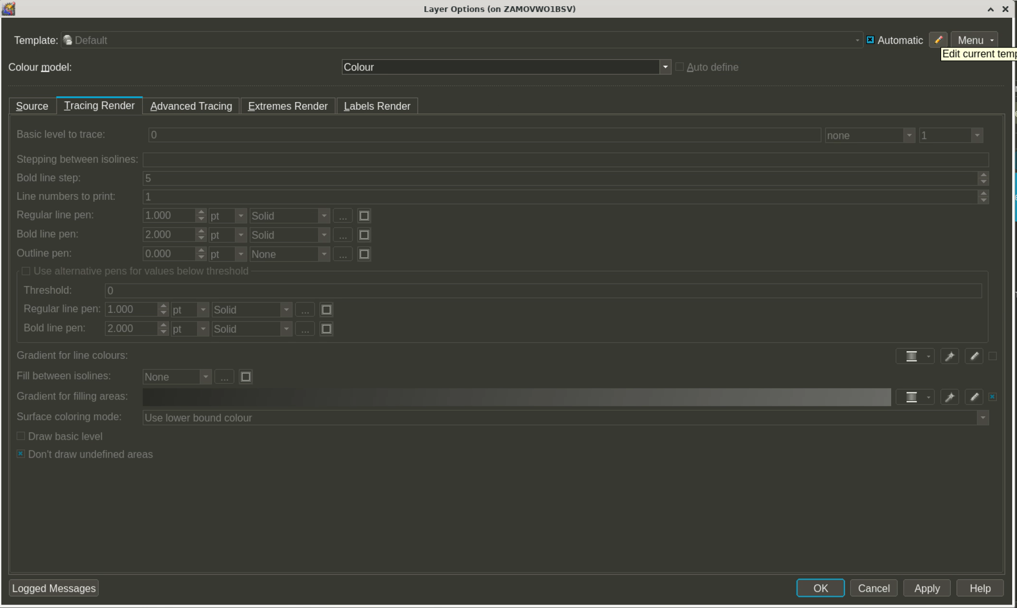

Slide 44
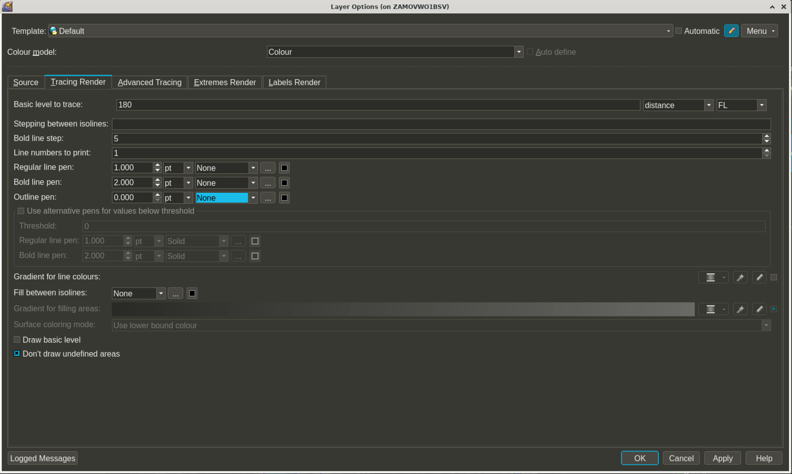

Slide 45
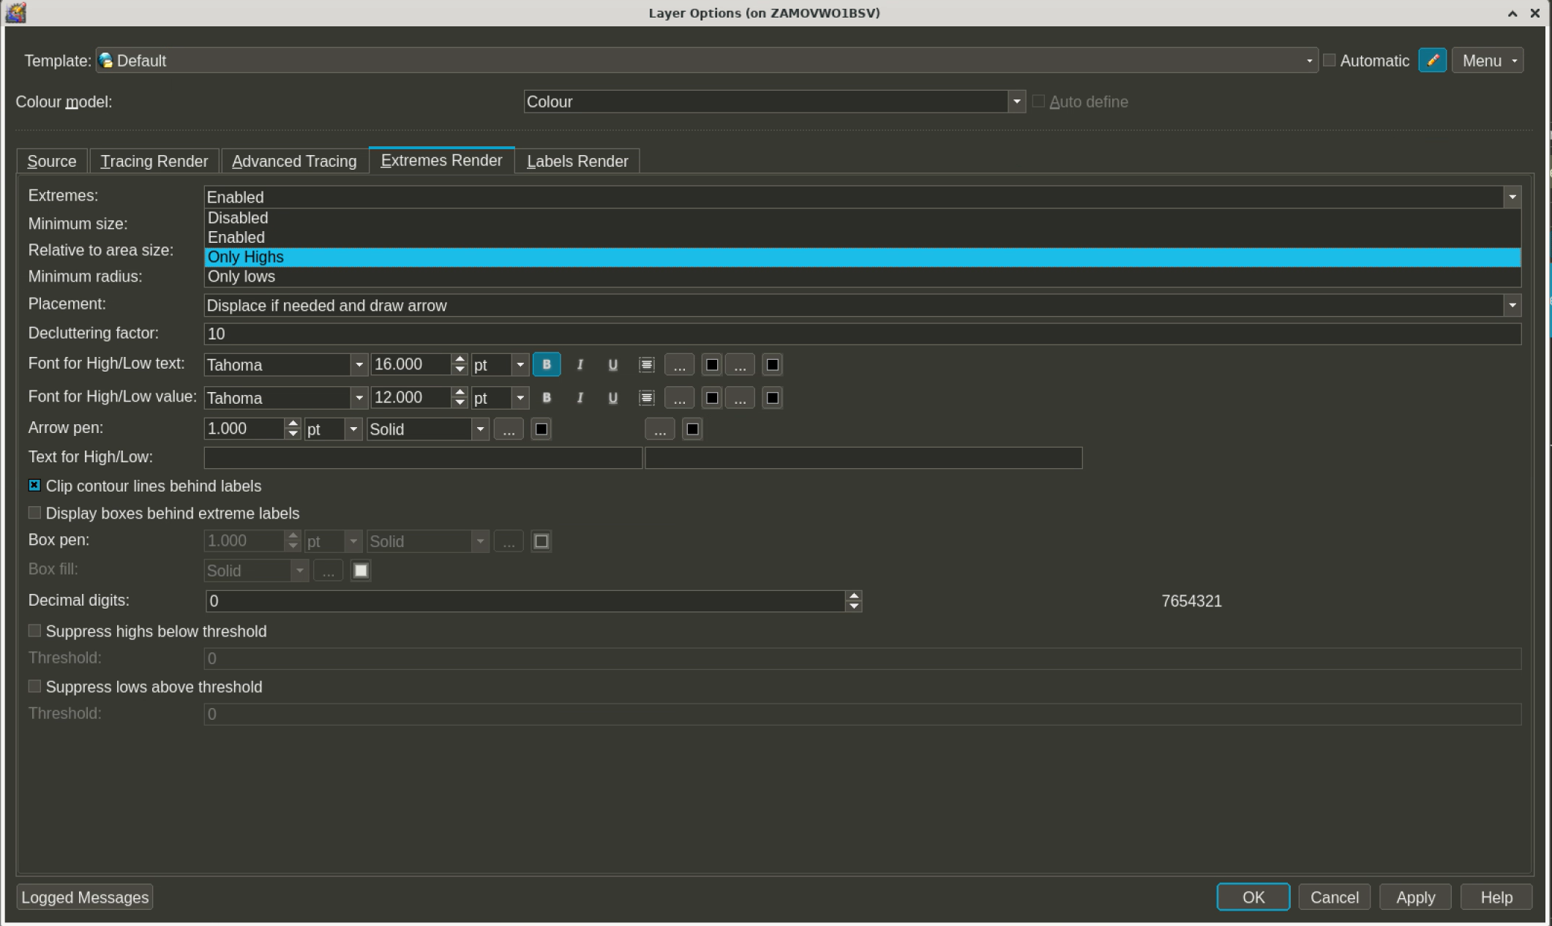

Slide 46
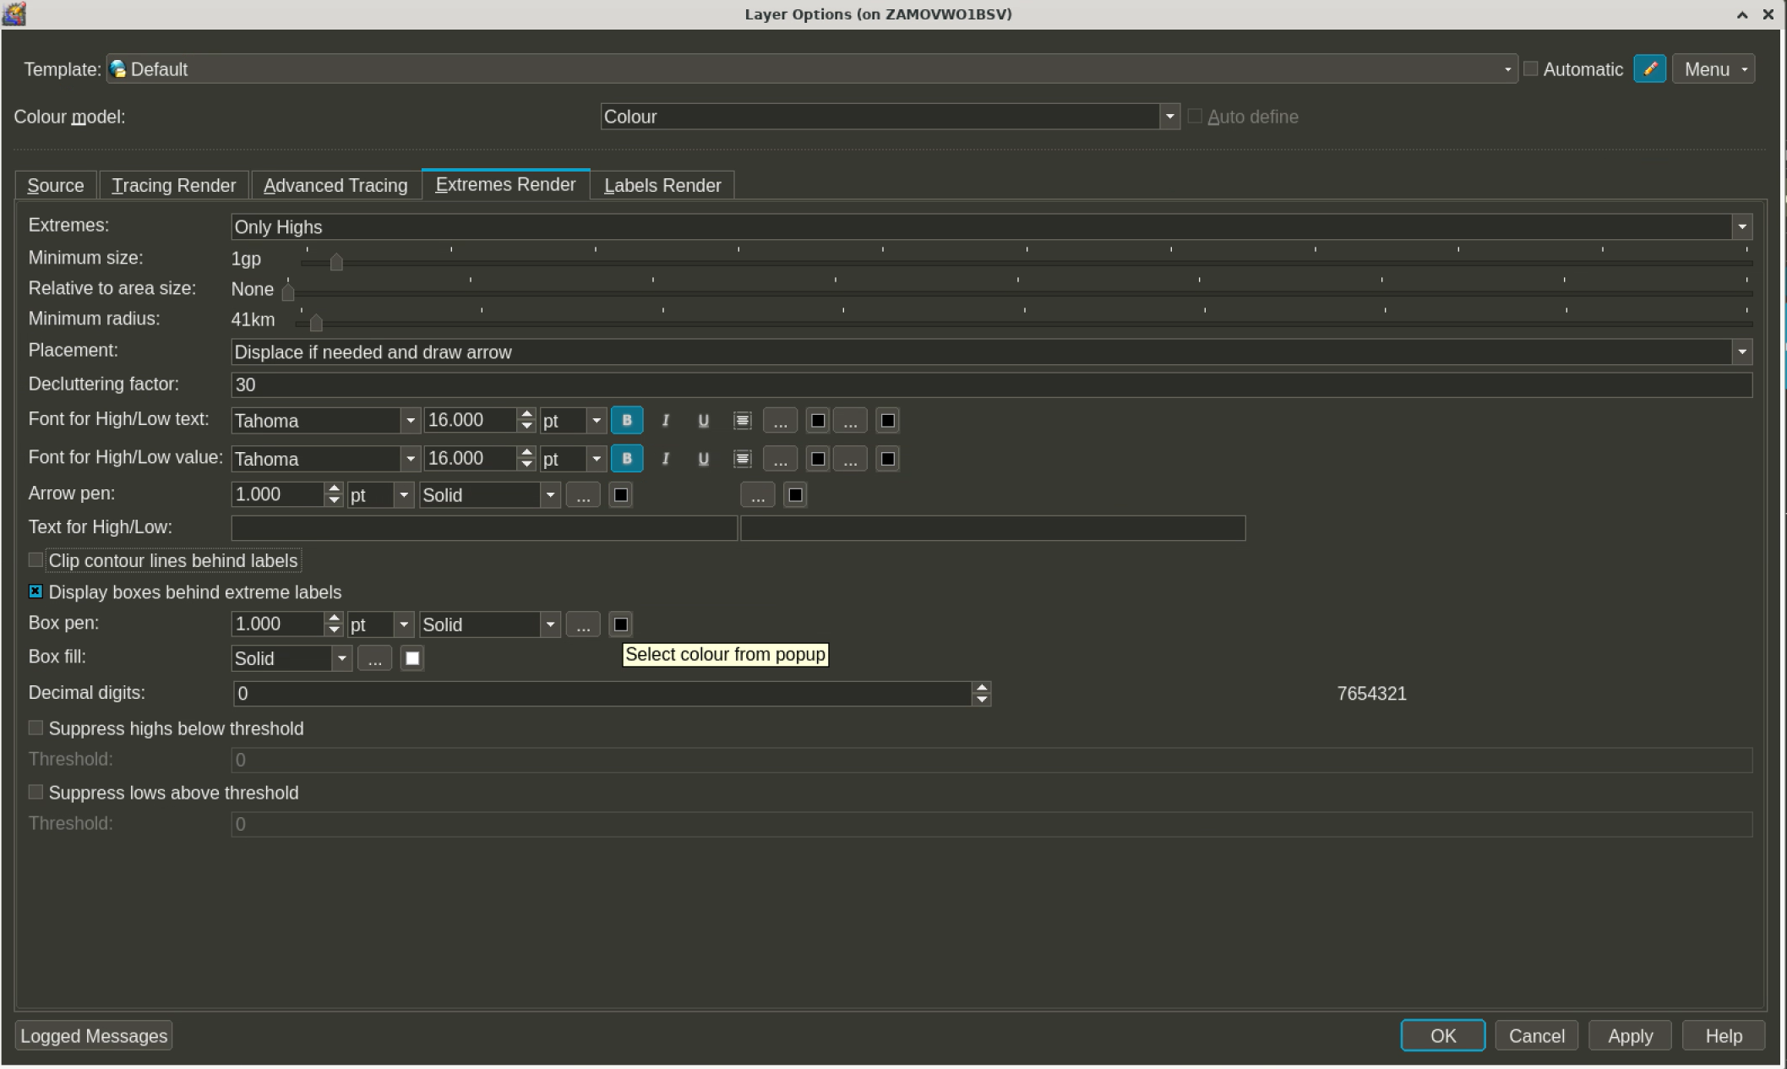

Slide 47
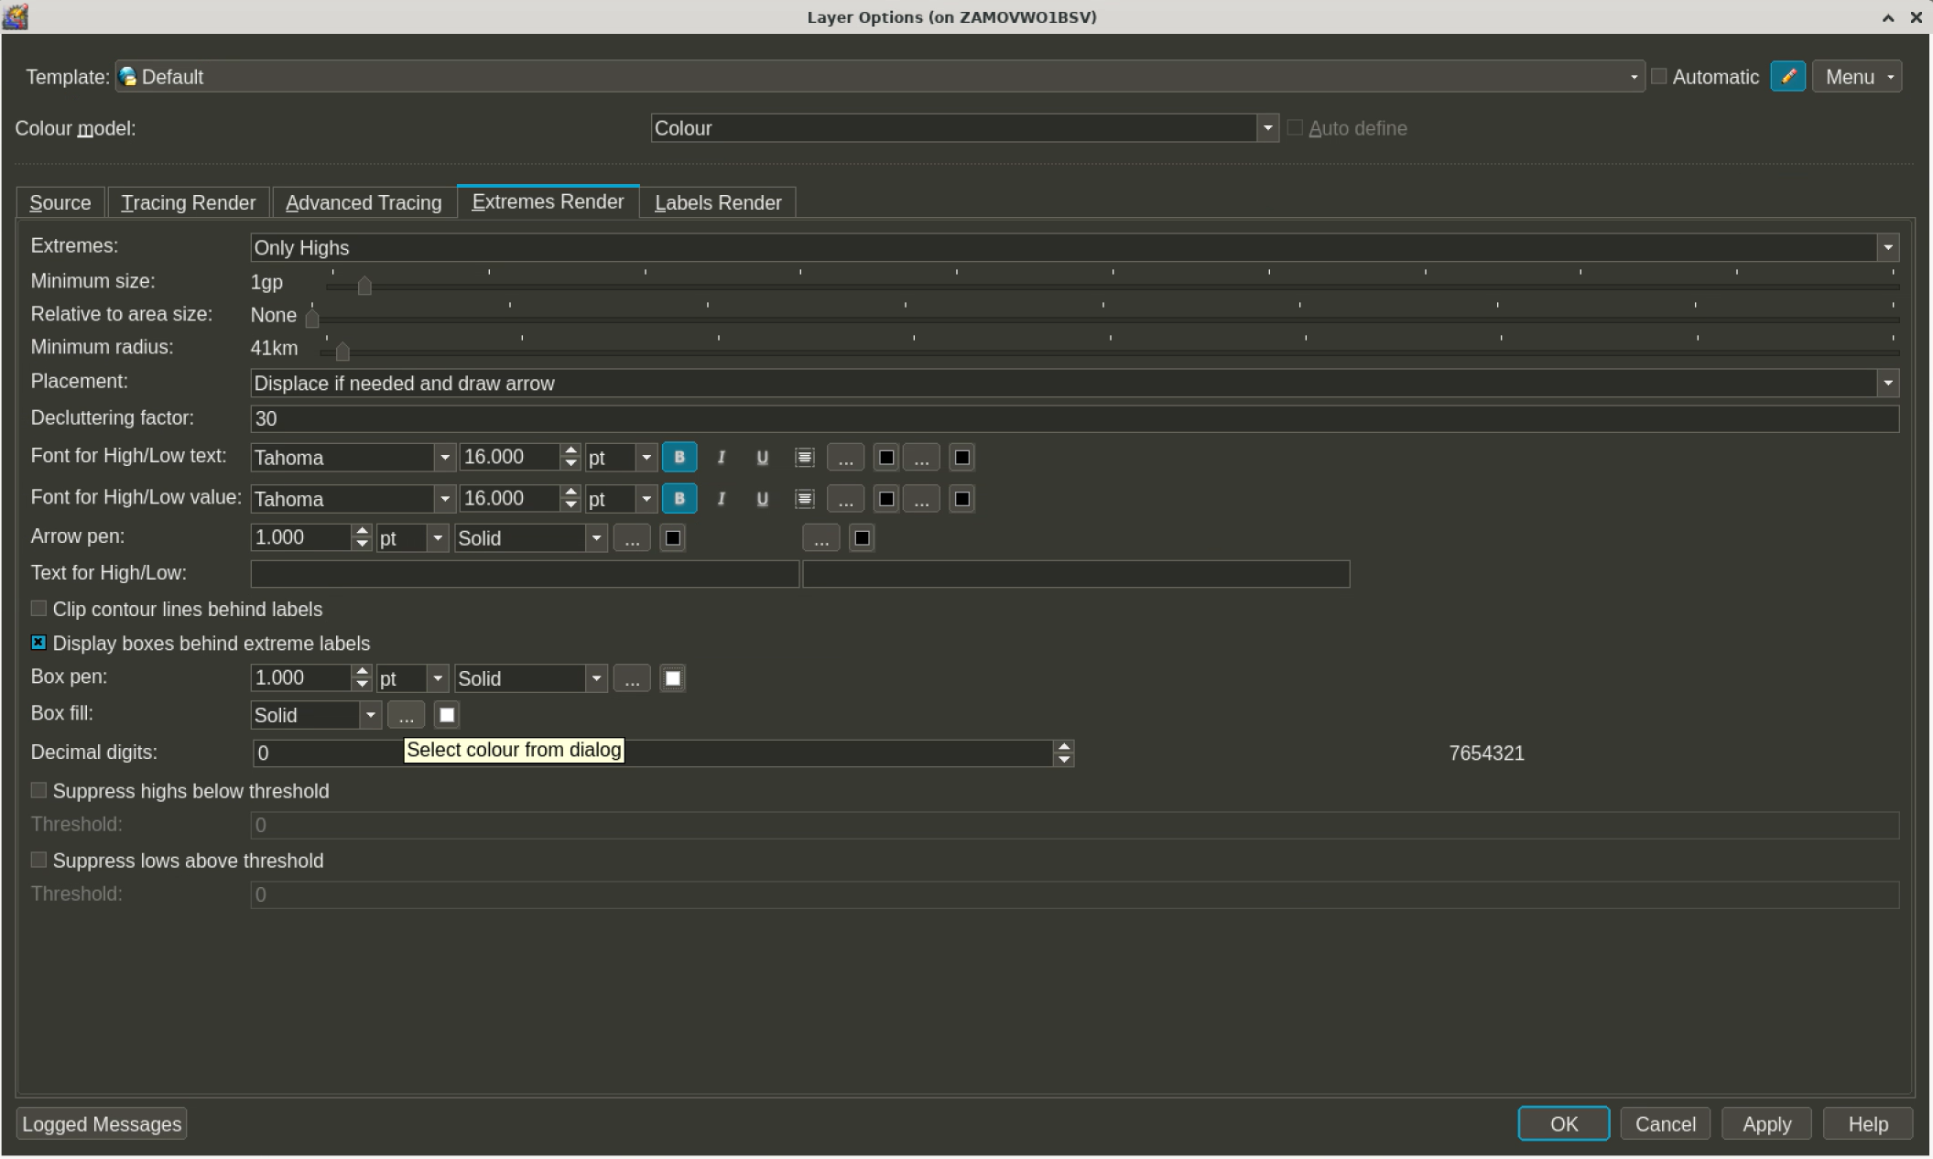

Slide 48
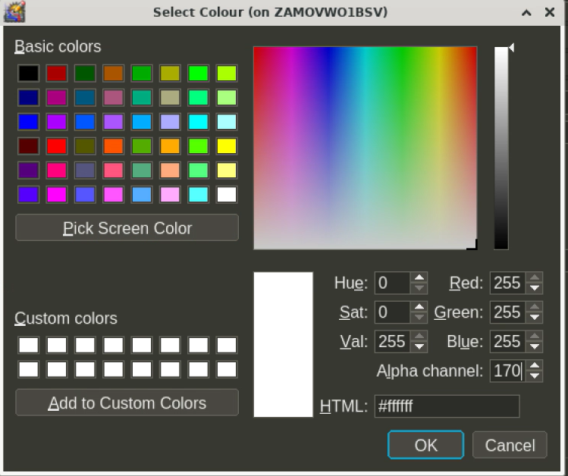

Slide 49
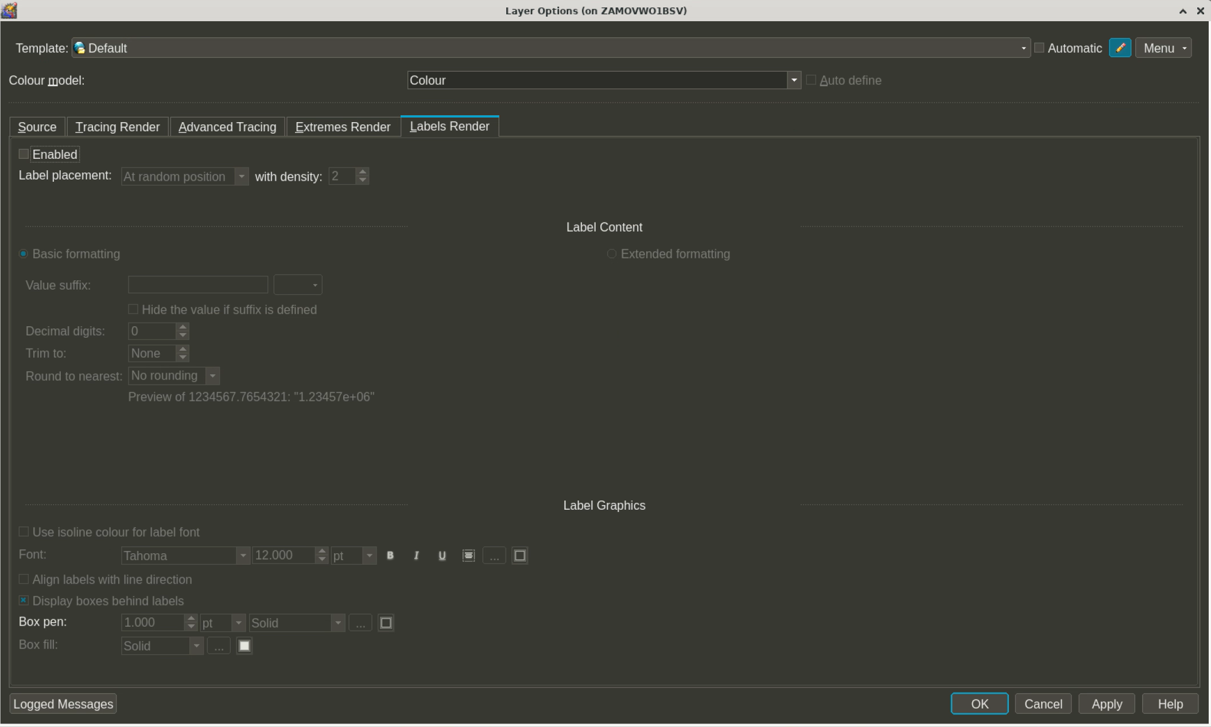

Slide 50
